Slide 1
Clinico-biological prognostic biomarkers in melanoma patients with brain metastases treated with immunotherapy
Piotr Błoński
Supervisor: Prof. Anna Czarnecka MD PhD

Slide 2
Summary of achievements

Slide 3
Achievements: October 2024 – April 2025
Full-text publications:
Internship:
24th March – 7th April 2025, at the Netherlands Cancer Institute, Prof. Christian Blank’s Team and the Melanoma Working Group (acknowledgements to Minke Lucas and Prof. Christian Blank!)
Conferences:
ESTRO 2025
1. Outcomes of stereotactic radiotherapy as first-line local treatment of melanoma patients with brain metastases (co-author)
16th international conference of contemporary oncology
Polskie wyniki leczenia iBRAF+MEK u chorych na zaawansowanego czerniaka (co-author)
21st EADO Congress & 11th World Congress of Melanoma
Treatment with avelumab of patients with inoperable and metastatic Merkel cell carcinoma: the results of multicenter study (co-author)
Deescalation of immunotherapy in metastatic melanoma patients with scheduled drug holidays (co-author)
The Efficacy of Encorafenib with Binimetinib in the Treatment of Patients with Advanced Melanoma - Real-world Evidence (co-author)
VI Kongres Onkologii Polskiej
Leczenie zaawansowanego raka płaskonabłonkowego skóry cemiplimabem- wyniki badania wieloośrodkowego (co-author)
Skuteczność dabrafenibu z trametynibem w leczeniu pierwszej, drugiej i trzeciej linii chorych na zaawansowanego czerniaka (co-author)
Wakacje terapeutyczne podczas immunoterapii pacjentów z zaawansowanym i przerzutowym czerniakiem skóry (co-author)

Slide 4
Update on the research project status

Slide 5
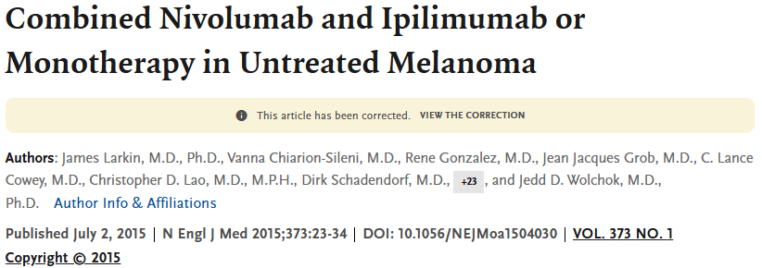
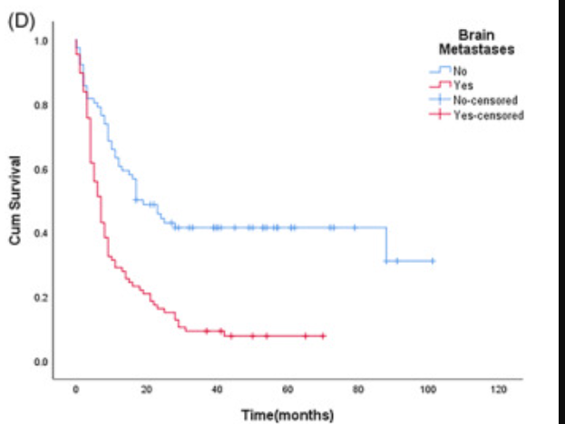
Background
Brain metastases:
NO
YES

Slide 6
Summary of the study objectives
Aim of the study:
to investigate the impact of methylation pattern, immunophenotype and gene expression profiling of tumor microenvironment (TME) in melanoma patients with brain metastases treated with Combo immunotherapy
Objectives to investigate in context of clinical outcomes:
gene expression and methylation profile
immuphenotype of tumour microenvironment (TME)
TMB, INF gamma signature, mutational status

Slide 7
Eligibility criteria
Inclusion:
1. Confirmed diagnosis of metastatic melanoma with known BRAF mutation status
2. At least 18 years of age at start of treatment 3. Received at least 1 line of treatment (with anti-PD1 + anti-CTLA-4 referred as to combo)
4. anti-PD1 + anti-CTLA-4 therapy in first-line treatment
5. Available FFPE tissue for molecular analysis before the start of immunotherapy​
​6. FFPE blocks obtained from tumors/metastases detected no more than 6 months before the start of immunotherapy ​
Exclusion:
1. Lack of brain metastases before combo treatment
2. Leptomeningeal disease
3. Second metastatic cancer

Slide 8
Patient selection and sample collection
NIO-PIB
Italian sites
Data from: Prof. Mario Mandala, dr Luca Romano
Clinical screening
570 patients treated with IPI+NIVO
10 patients screened
124 had brain metastases
51 screen failures
4 screen failures
78 patients met all clinical eligibility criteria
6 patients met all clinical eligibility criteria
Biomaterial screening - FFPE quality assessment
34 patients are eligible
18 patients – assessment pending
Sample transfer to be performed
26 patients – not eligible

Slide 9
Patient selection and sample collection - summary
From NIO-PIB, 34 patients are now fully eligible for the project.
13 of them have also paired healthy tissue sample.
18 are undergoing biomaterial screening (FFPE quality assessment).
Form Itailan sites, one sites has declared eligbility of 6 of 10 screened patients, FFPE review will be performer after sample transfer.
In other Italian sites, the screening is pending.

Slide 10
Molecular analysis – schedule of events
Biomaterial processing
Step 1
Step 2
FFPE
Multiplex IHC
WES/TSO 500 panel* for DNAseq
DNA/RNA extraction
AmpliSeq for Illumina Immune Response Panel for RNAseq
Biobanking
Methylation analysis
NIO-PIB
Italian sites
* - to be decided

Slide 11
Final thoughts

Slide 12
Challanges and expected bottlenecks
Completion of the screening in Poland – expected May 2025.
Completion of the screening in Italy – expected July 2025.
Completion of FFPE review (and macrodissection, if necessary) – expected July/August 2025.
DNA/RNA extraction (and biobanking for mathylation analysis later) – expected September 2025.

Slide 13
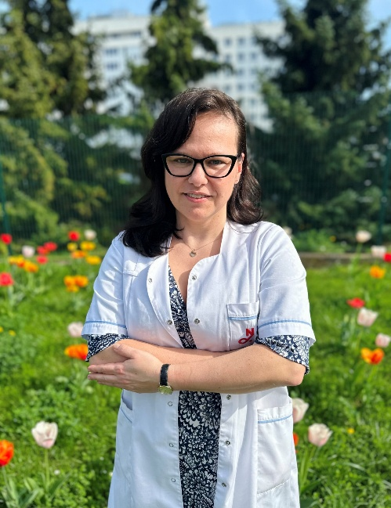
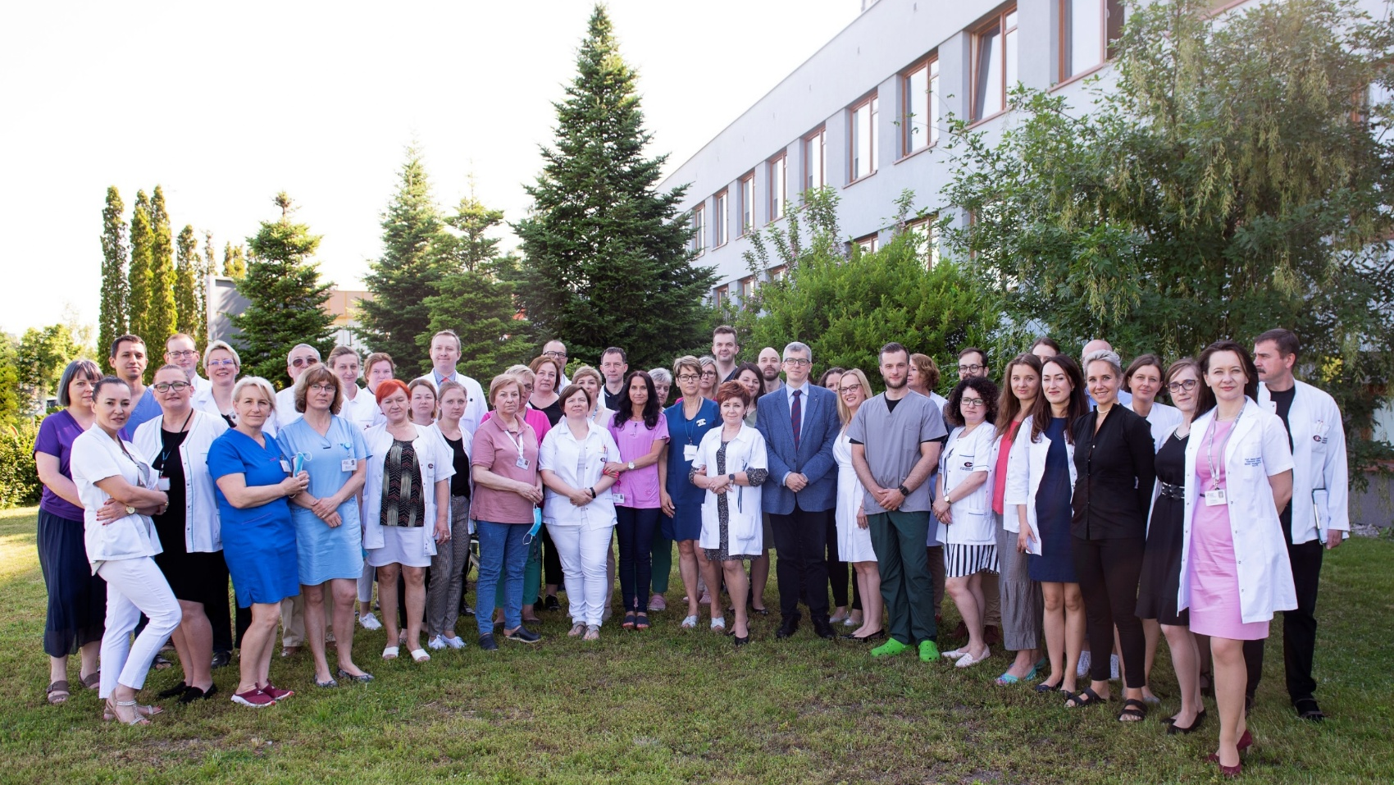
dr Jakub Piątkowski
Prof. Anna Czarnecka MD PhD, supervisor
Prof. Anna Szumera-Ciećkiewicz MD PhD
Biobank, NIO-PIB
Department of Soft Tissue/Bone Sarcoma and Melanoma, NIO-PIB
Medical oncology
Hanna Koseła-Paterczyk, MD PhD DSc
Prof. Anna M. Czarnecka, MD PhD DSc
Tomasz Świtaj, MD PhD
Sławomir Falkowski, MD
Katarzyna Kozak, MD PhD
Paweł Teterycz, MD PhD
Paulina Jagodzińska-Mucha, MD PhD
Anna Klimczak, MD
Paweł Rogala, MD PhD
Joanna Placzke, MD
Monika Dudzisz-Śledź, MD PhD
Krzysztof Ostaszewski, MD
Anna Mariuk-Jarema, MD
Paweł Sobczuk, MD PhD
Sylwia Kopeć, MD
Karolina Sosnowska, MD
Katarzyna Kisielewska, MD
Karolina Helbig, MD
Jędrzej Żukowski, MD
Radiotherapy
Mateusz Spałek, MD PhD Dsc
Aneta Borkowska, MD PhD
Tadeusz Morysiński, MD PhD
Molecular Biology
Agnieszka Zając, MSc
Klaudia Bobak, MSc
Mritunjoy Dey, MSc
Surgery
Prof. Piotr Rutkowski, MD PhD DSc
Marcin Zdzienicki, MD PhD
Andrzej Pieńkowski, MD PhD
Maciej Sałamacha, MD
Iwona Kalinowska, MD
Jacek Skoczylas, MD
Bartłomiej Szostakowski, MD PhD
Beata Mitręga-Korab, MD
Konrad Zaborowski, MD
Maria Krotewicz, MD
Wojciech Kwiatkowski, MD
Sławomir Wajman, MD
Dorota Kuryga MD
Natalia Siok, MD

