Slide 1



Investigating spatial heterogeneity and tumor microenvironment interactions in high grade glioma using spatial transcriptomics
PhD candidate: Shrinath Dhanapal
Supervisor: Prof. Dr. Hab. Bożena Kamińska-Kaczmarek
Laboratory of Molecular Neurobiology,
Nencki Institute of Experimental Biology PAS, Warsaw, Poland.

Slide 2
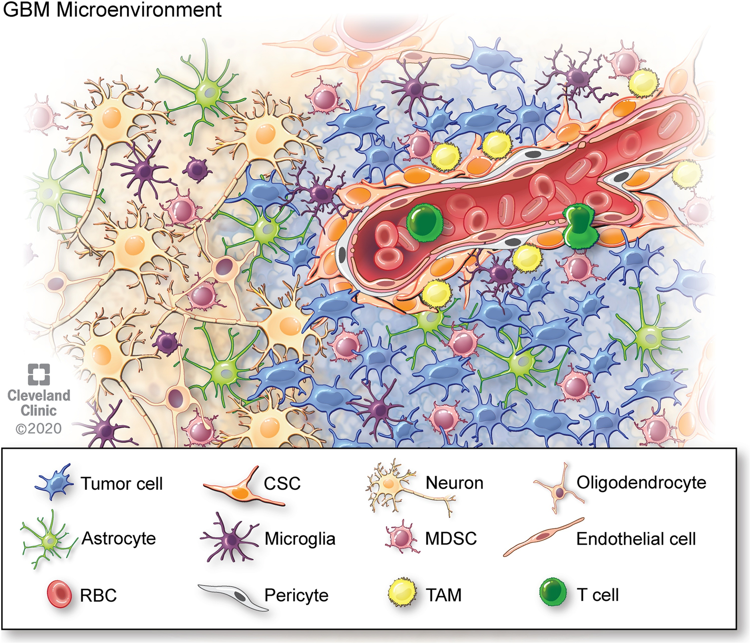
Glioblastoma:
Glioblastoma (GBM) is a malignant brain tumor and remains one of the most aggressive and treatment-resistant brain tumors, characterized by cellular heterogeneity, metabolic reprogramming, and complex cell-cell interactions within the tumor microenvironment (TME).
The TME comprises various cell types (endothelial cells, fibroblasts, immune cells, etc.) and extra-cellular components (cytokines, growth factors, hormones, extracellular matrix, etc.) that are surrounding tumor cells and nourished by a vascular network.

Slide 3
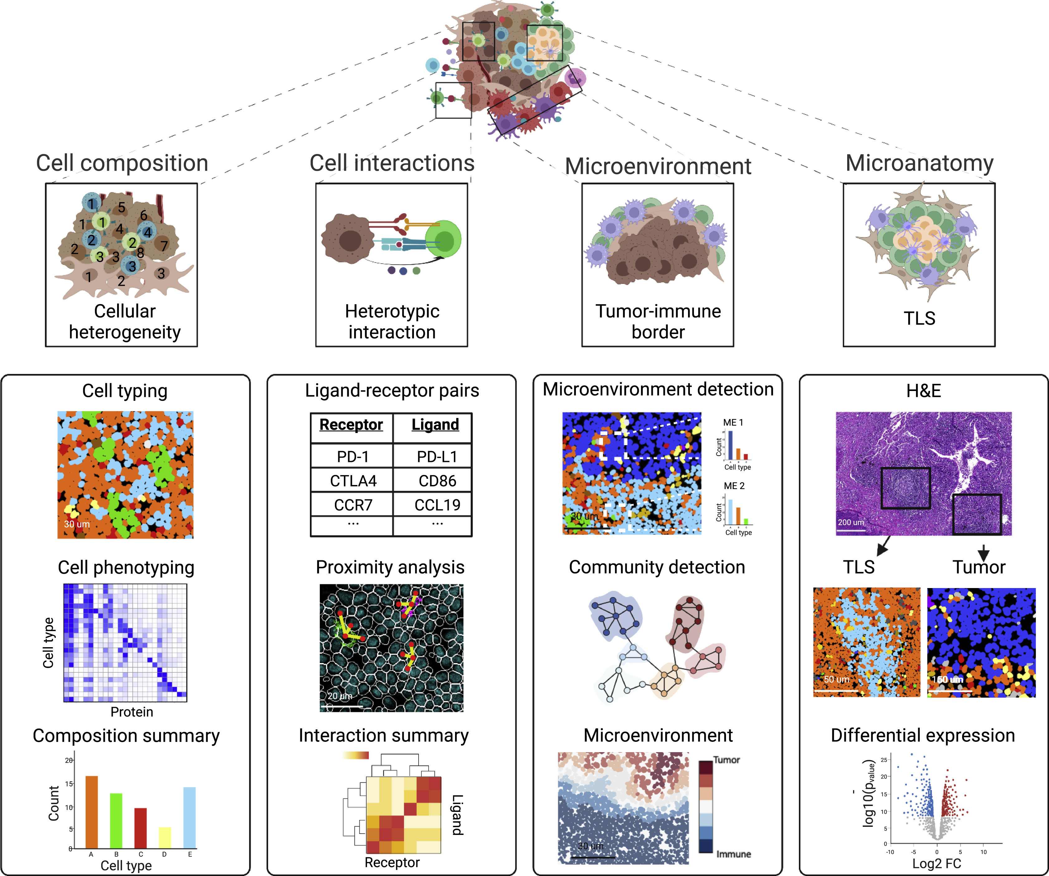
Aim of the study:
To comprehensively characterize the spatial organization and cellular heterogeneity of high grade gliomas, and to investigate tumor–immune cell interactions within the TME using the Visium Spatial Gene Expression platform (10x Genomics).

Slide 4

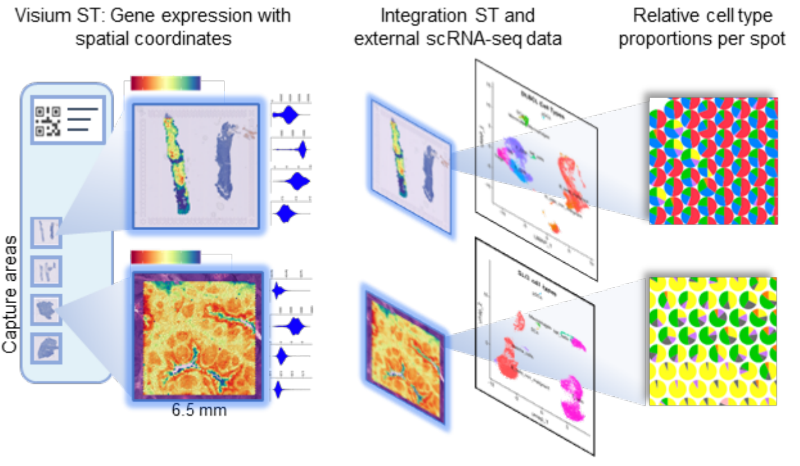

Experimental workflow:
Visium ST: Gene expression with spatial coordinates
Integration of ST and scRNA seq data
Relative cell type proportions per spot
Tissue Preparation
Notes:
Spatial Transcriptomics (10x Genomics Visium) is a powerful technology that enables the measurement of gene expression directly within tissue sections, while preserving the spatial context.
This means that researchers can determine not only which genes are being expressed, but also exactly where in the tissue those genes are active.
This allows for the detailed study of tissue architecture, cellular interactions, and disease microenvironments, and can uncover insights that traditional bulk or single-cell RNA-seq methods might miss due to loss of spatial context.

Slide 5
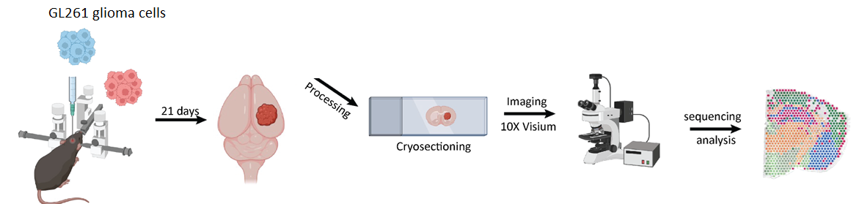
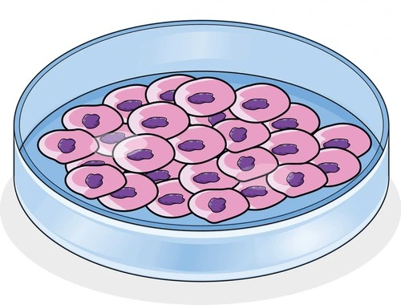
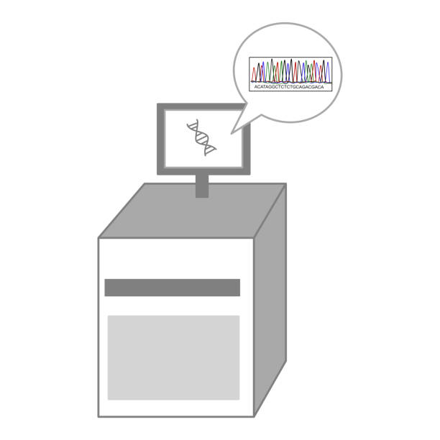
Animal Model:
GL261 tdT+luc+
glioma cells
Imaging and Sequencing
Notes:
GL261 glioma cell lines were cultured and subsequently implanted intracranially.
After 21 days, the mice were sacrificed, followed by perfusion, and the brains were harvested and frozen.
Brain sections were mounted onto Visium slides, stained, and imaged.
Library preparation was then carried out in accordance with the Visium Spatial Gene Expression protocol.
Then libraries were sequenced and produced data was analyzed.

Slide 6
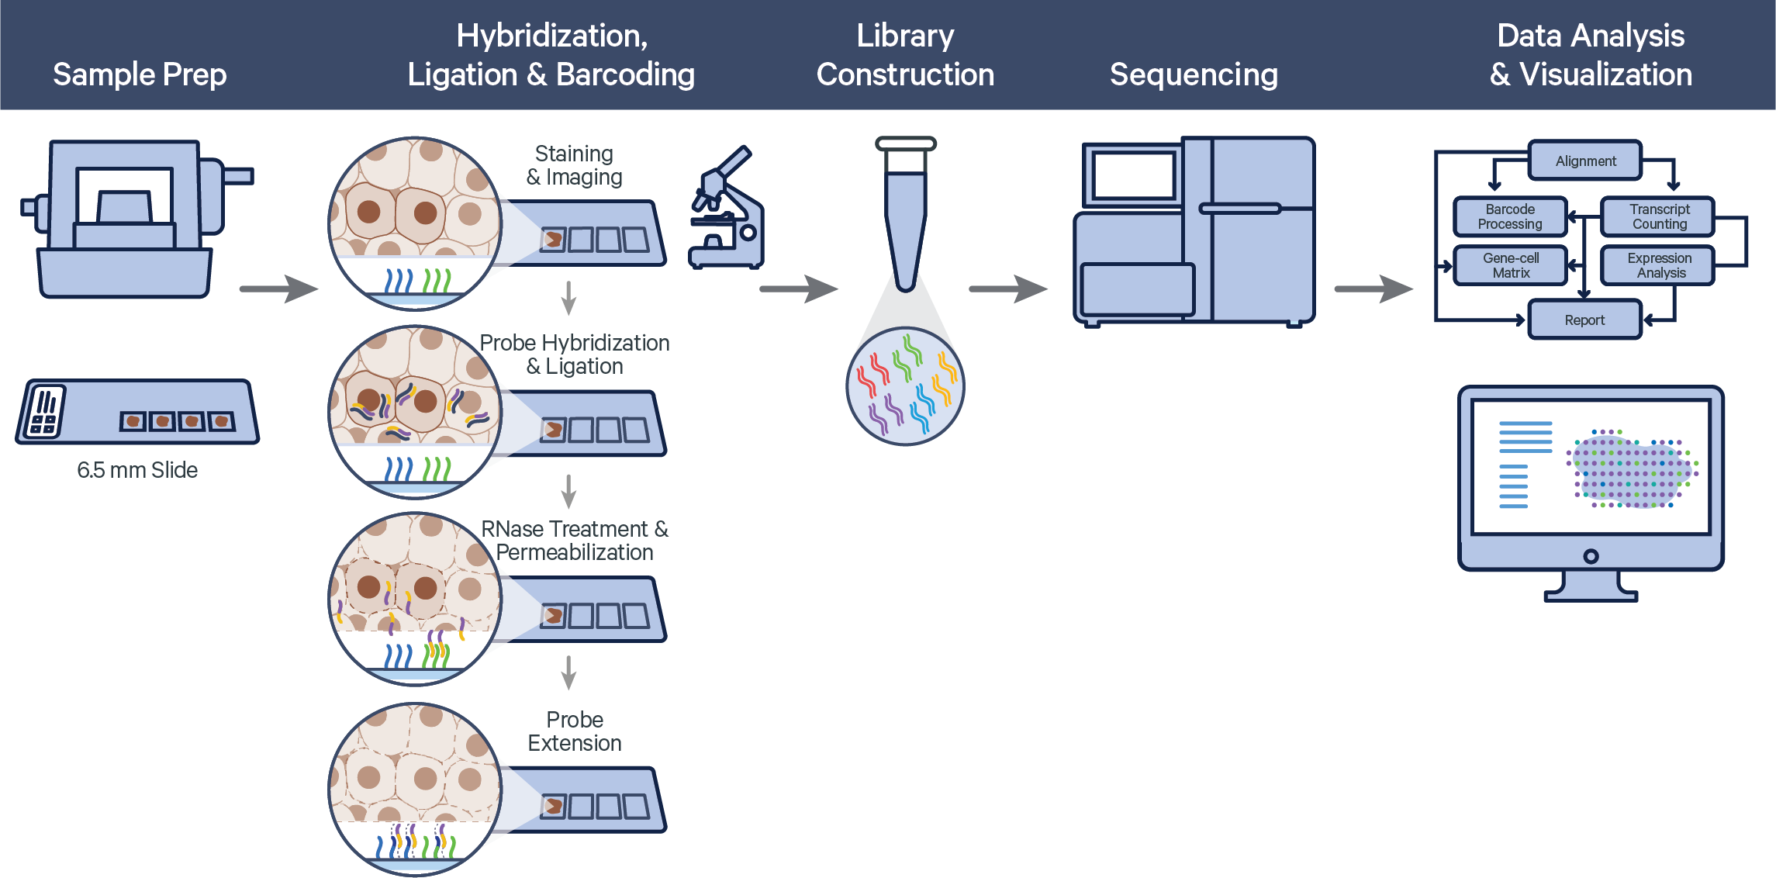
Technology: 10x Genomics Visium Spatial Transcriptomics(ST)
Space Ranger
Notes:
How Spatial Transcriptomics (10x Genomics Visium) works ?
Let’s go through the steps:
Tissue sectioning, : A thin tissue slice is placed onto a Visium slide containing spatially barcoded capture spots.
Staining & Imaging: The tissue is stained and imaged to preserve and record tissue morphology.
Probe Hybridization and Ligation : Specific probes hybridize to target RNA molecules. When two adjacent probes bind to the same RNA molecule, they are ligated together to enhance specificity.
Rnase Treatement and Permibilization: The tissue is permeabilized, allowing native mRNA to bind to the barcoded oligonucleotides at each spatial location.
Probe Extension: The ligated probe pairs are extended enzymatically to produce full-length probe products that carry transcript information and are ready for capture.
The next step is:
cDNA synthesis & Library Construction: Captured RNA or probes are reverse-transcribed into cDNA. Libraries are then prepared, amplified, each tagged with spatial and molecular barcodes.
Sequencing: The libraries are sequenced using next-generation sequencing platforms.
Data analysis: The sequencing data is computationally mapped back to the tissue image using SpaceRanger pipeline, resulting in a spatially resolved gene expression map.

Slide 7
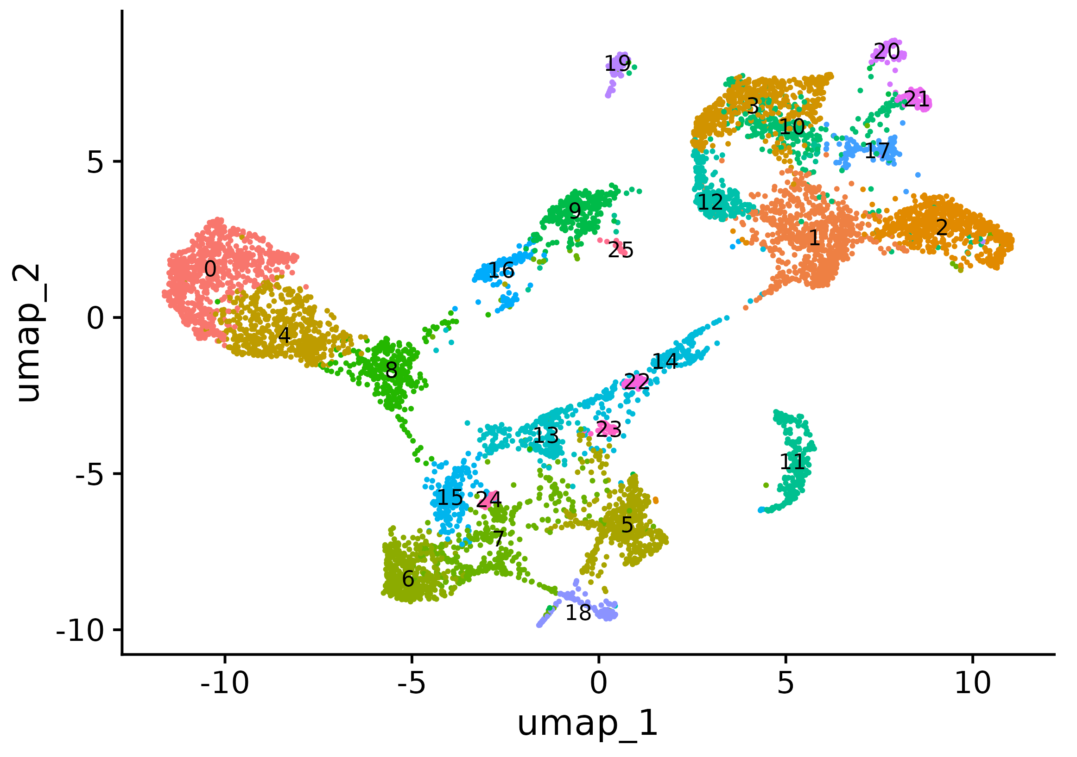
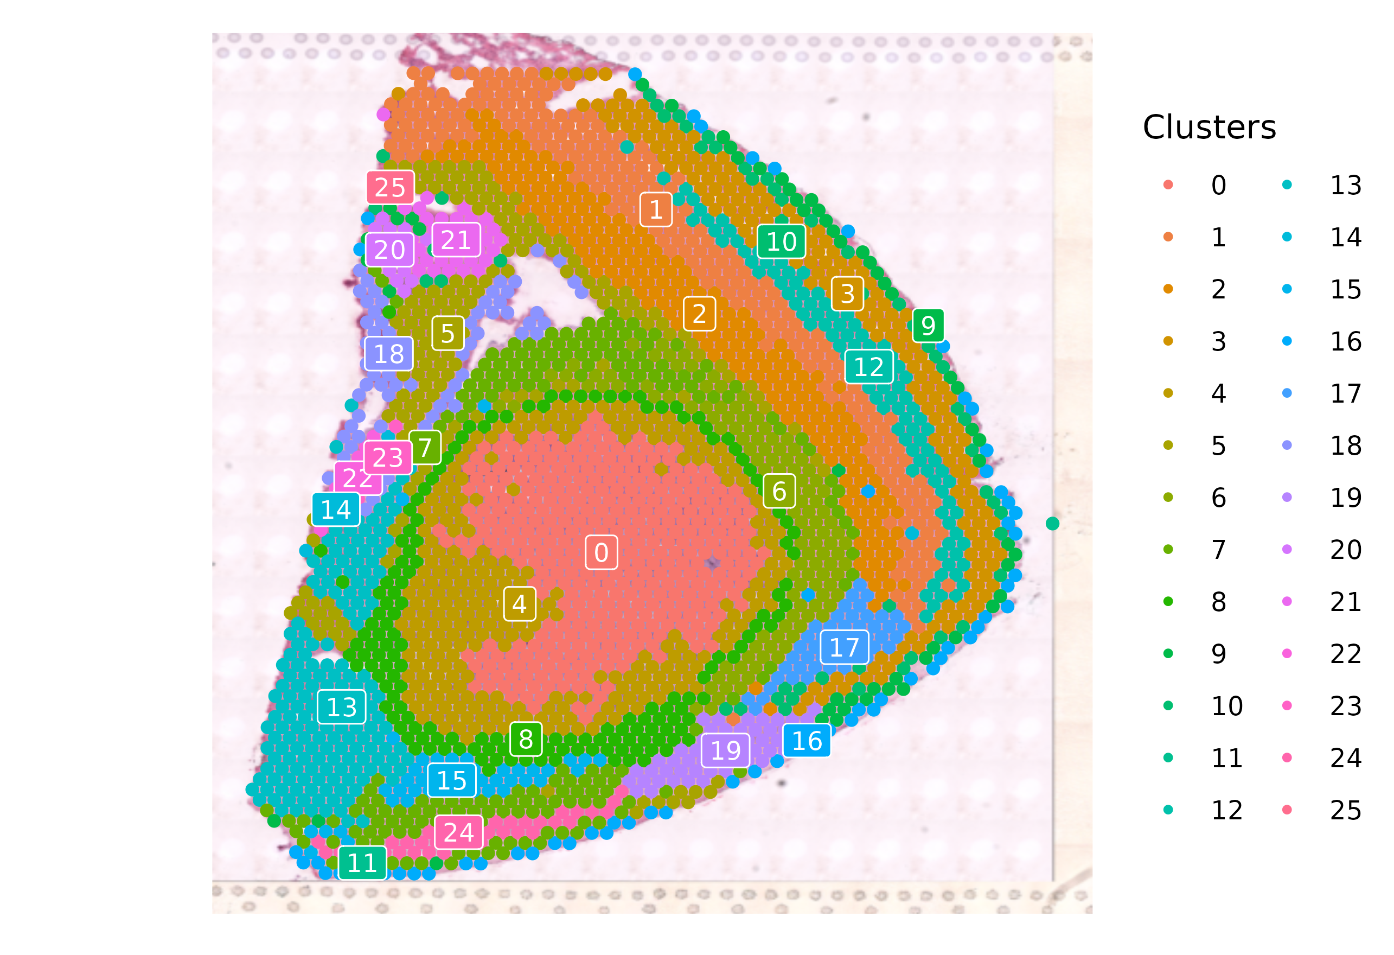
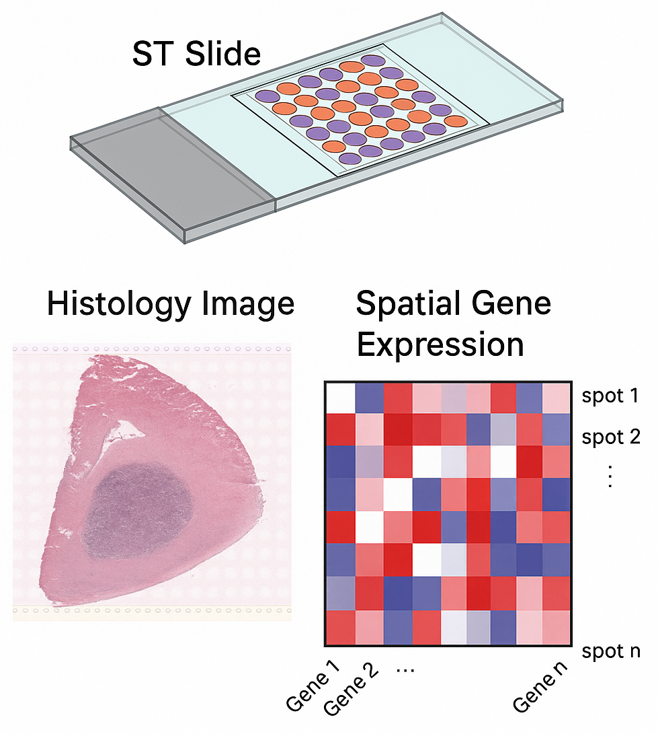
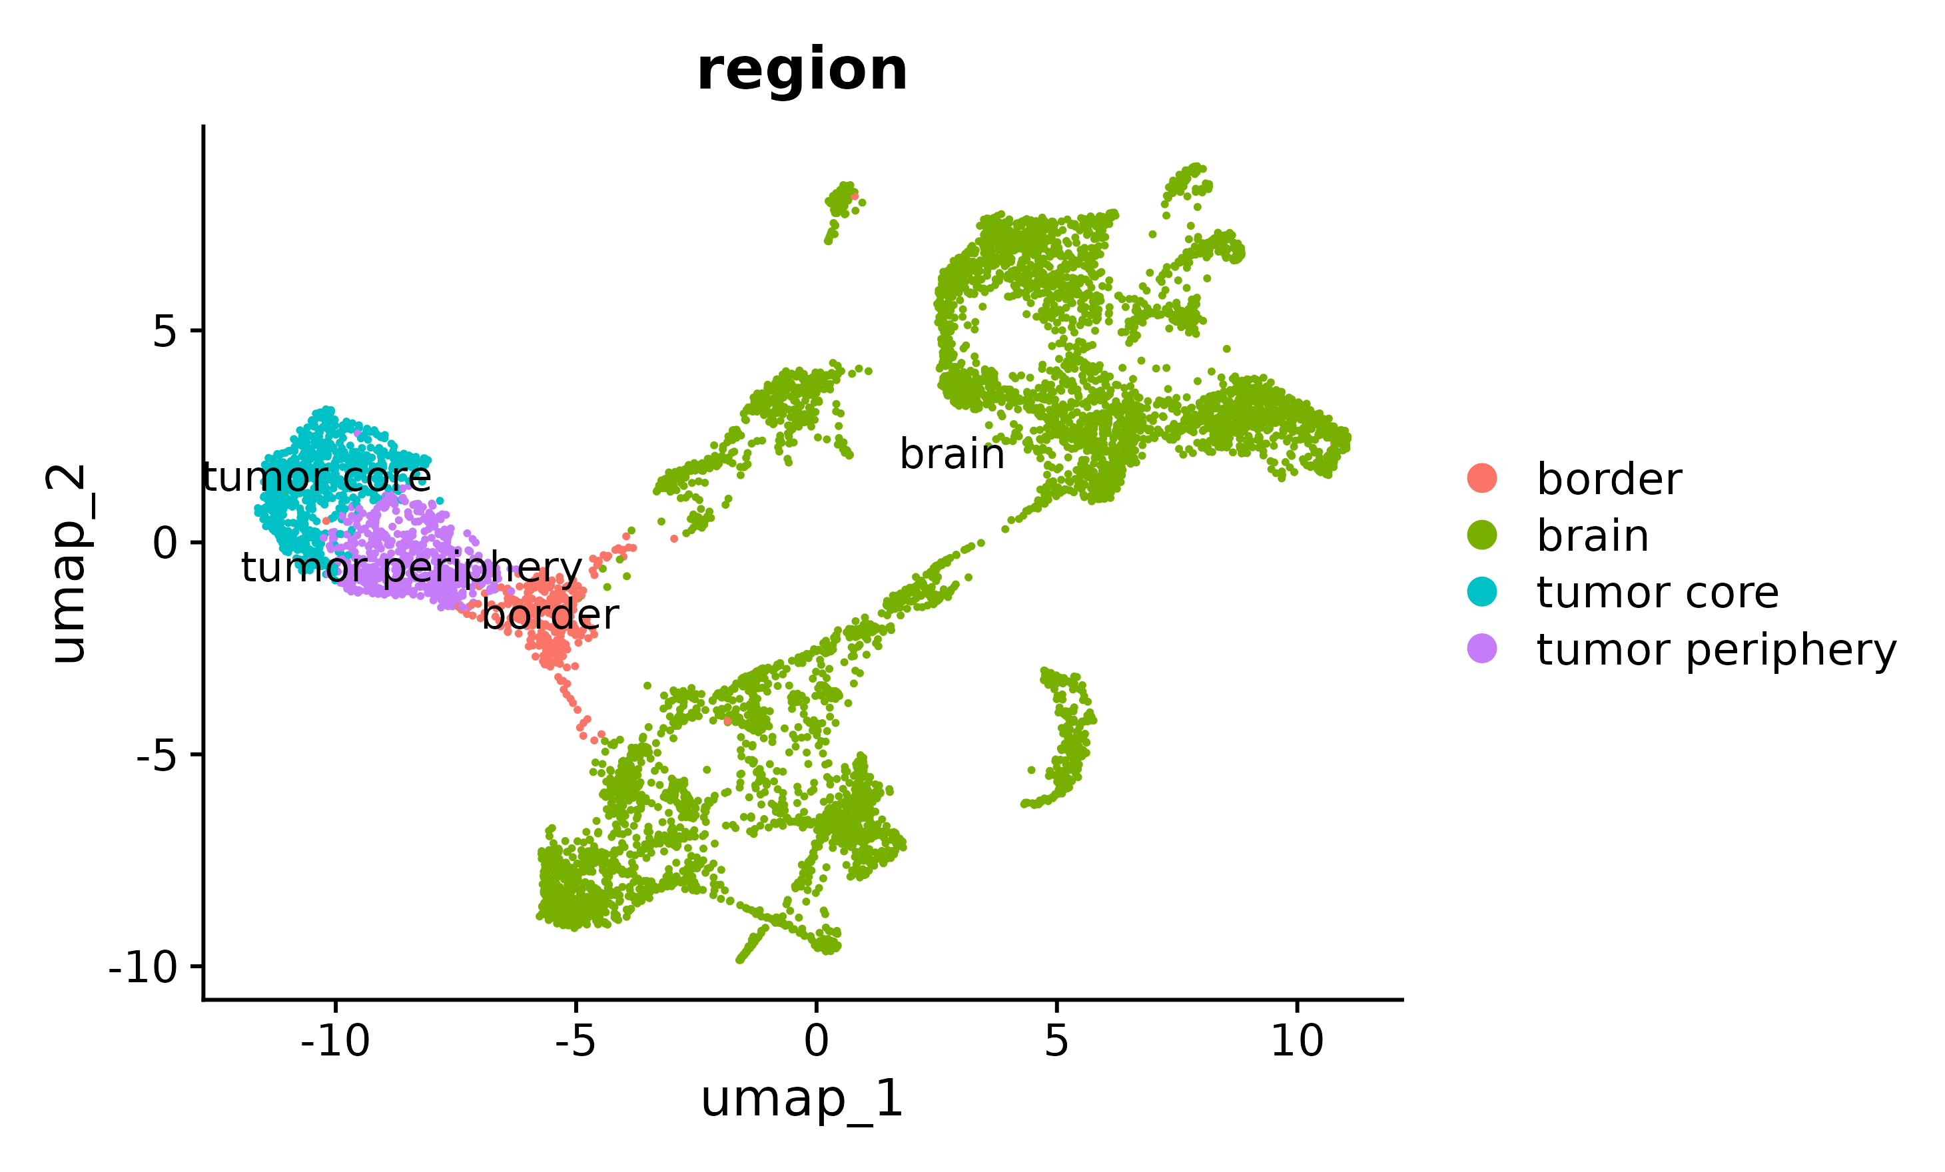
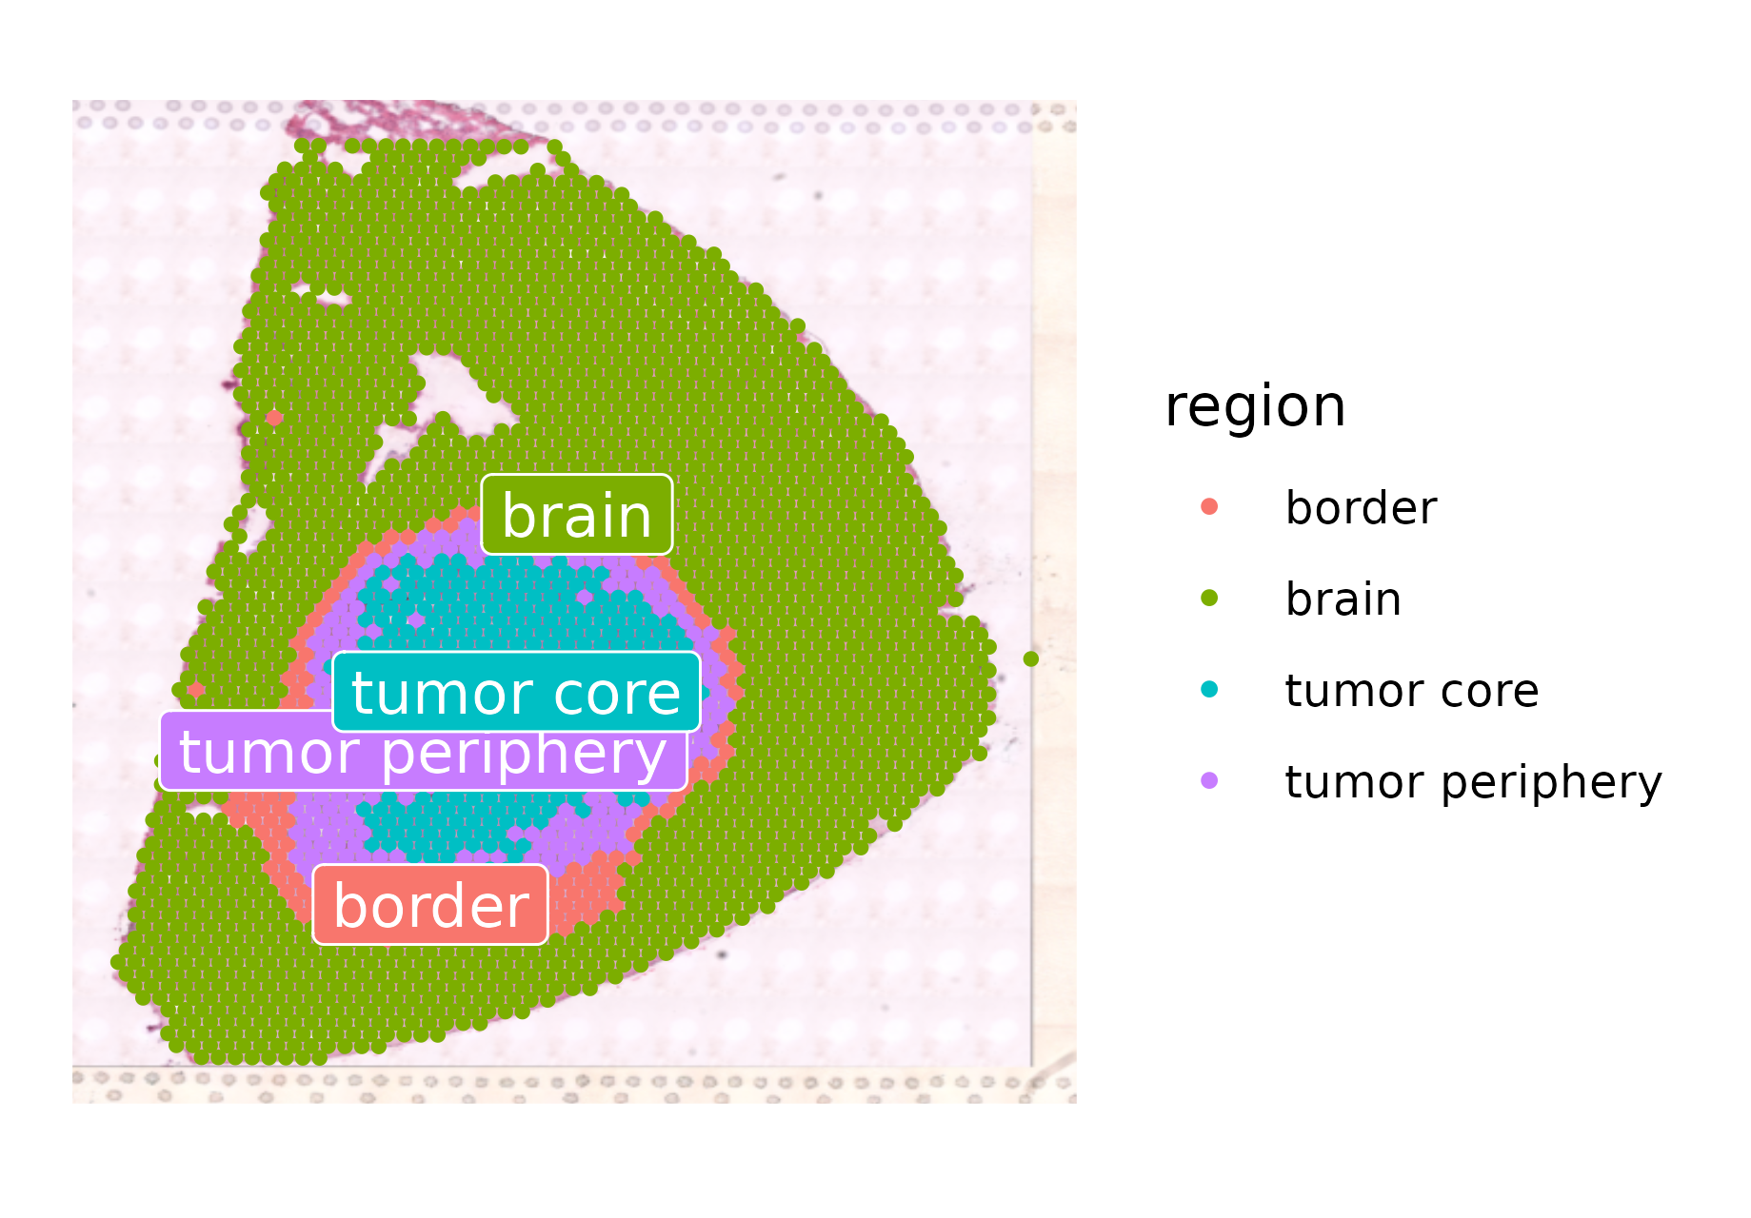
Preprocessing:
Dimensionality reduction and Clustering
Spatial Mapping

Slide 8
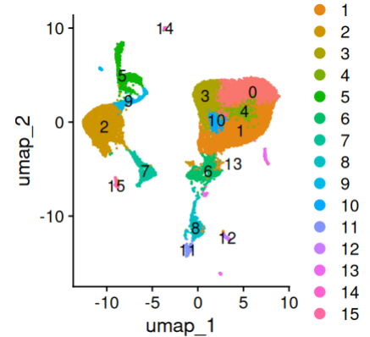
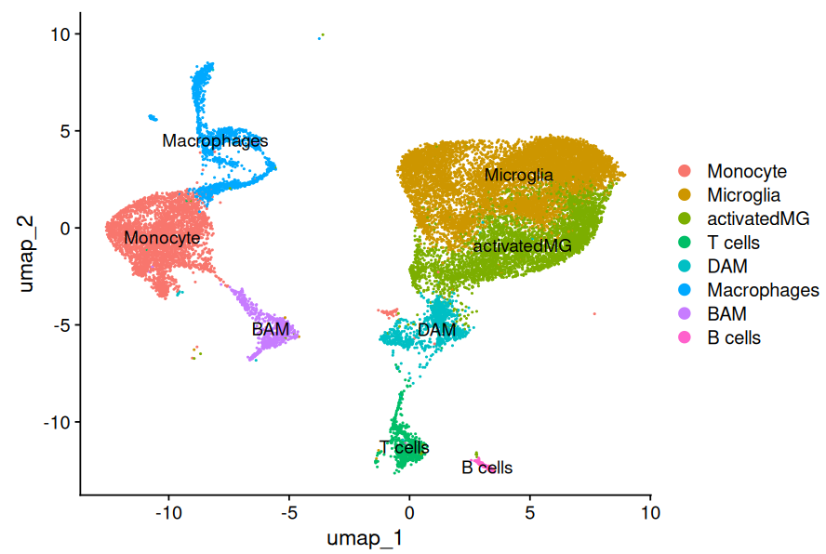
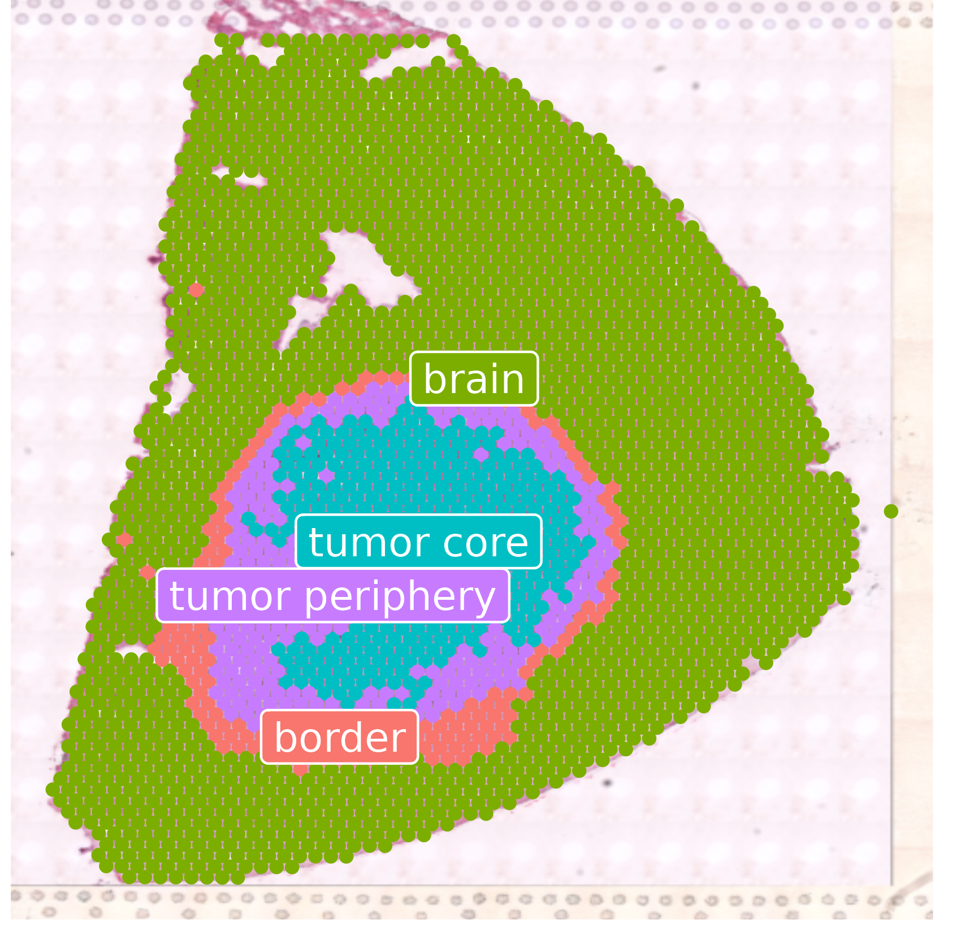
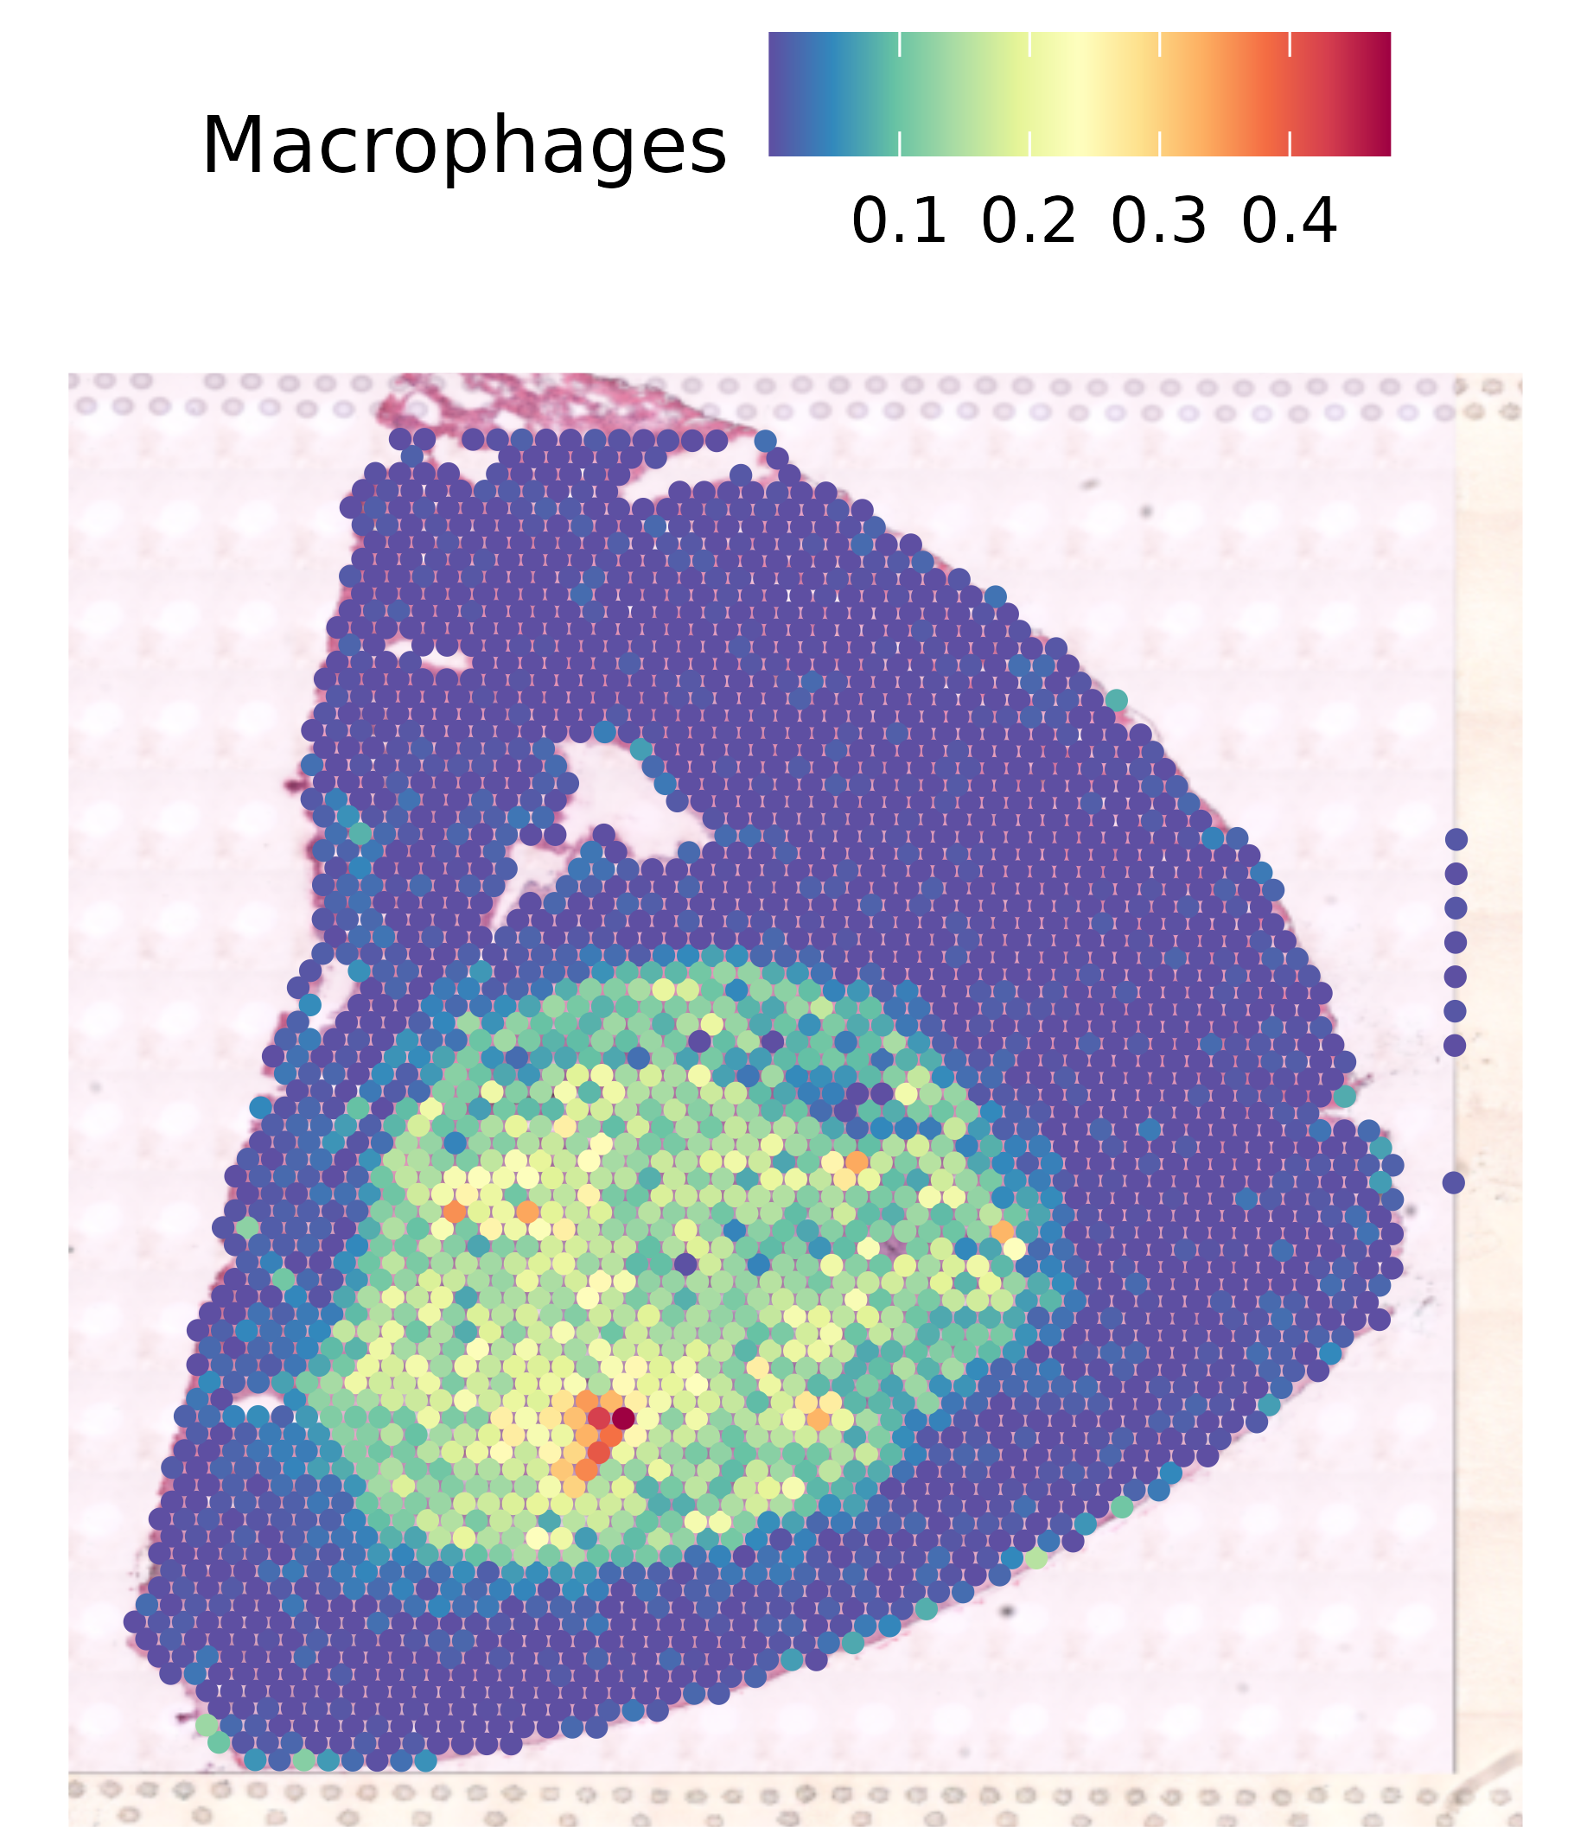
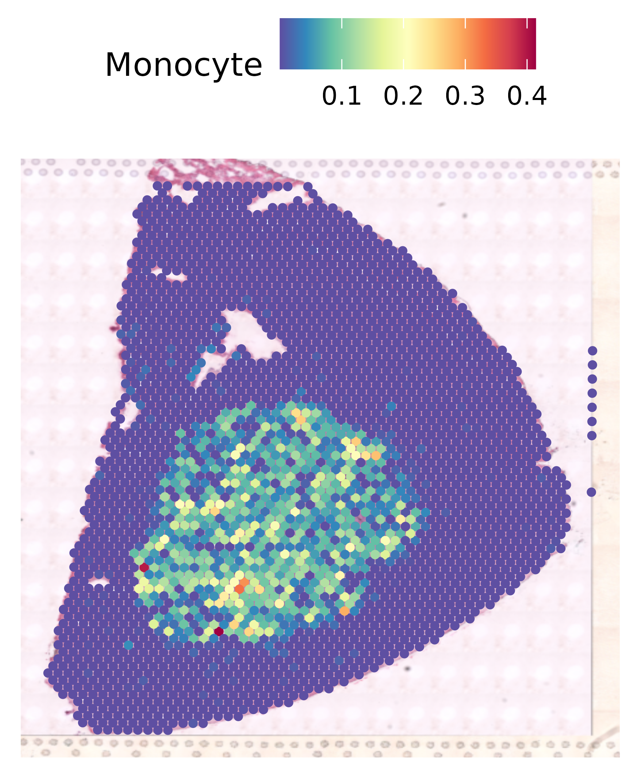
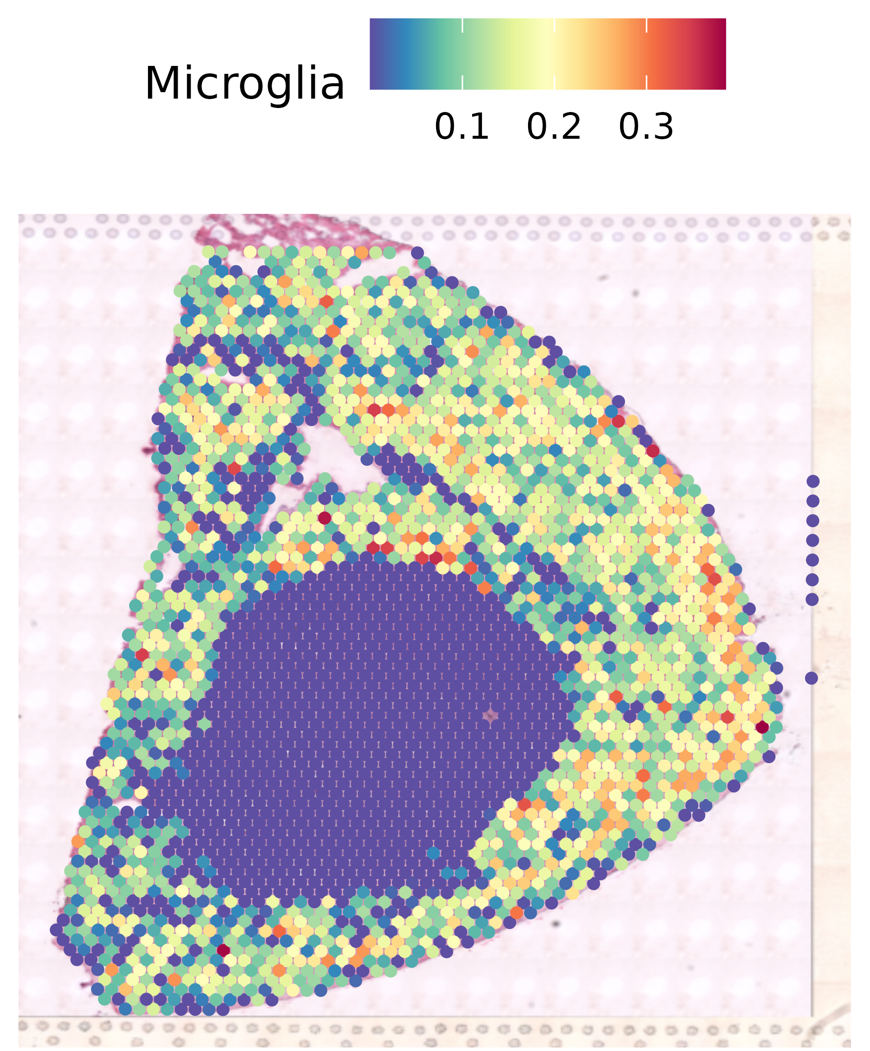
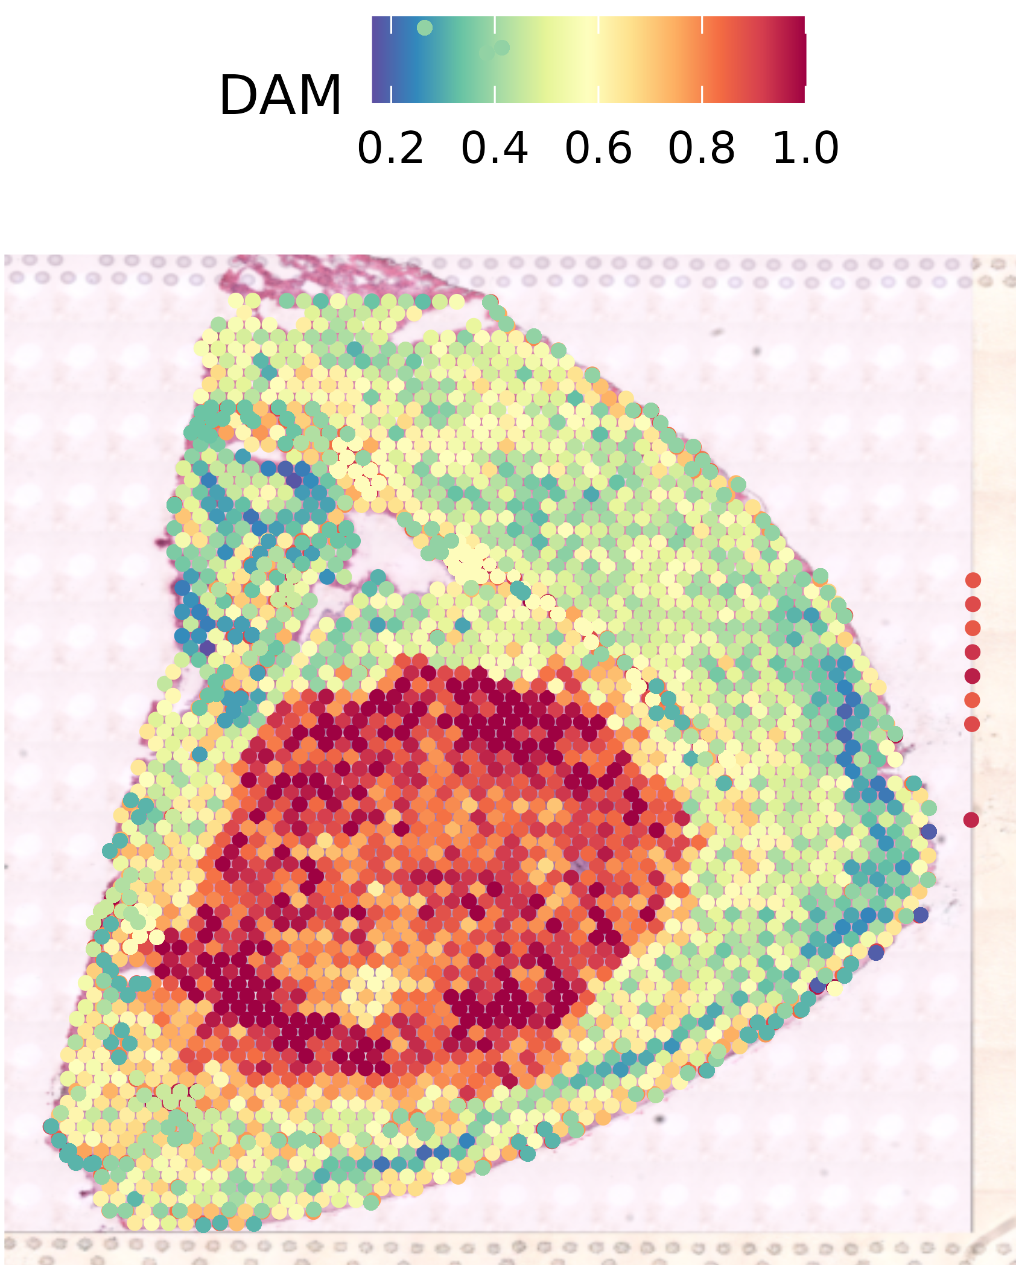
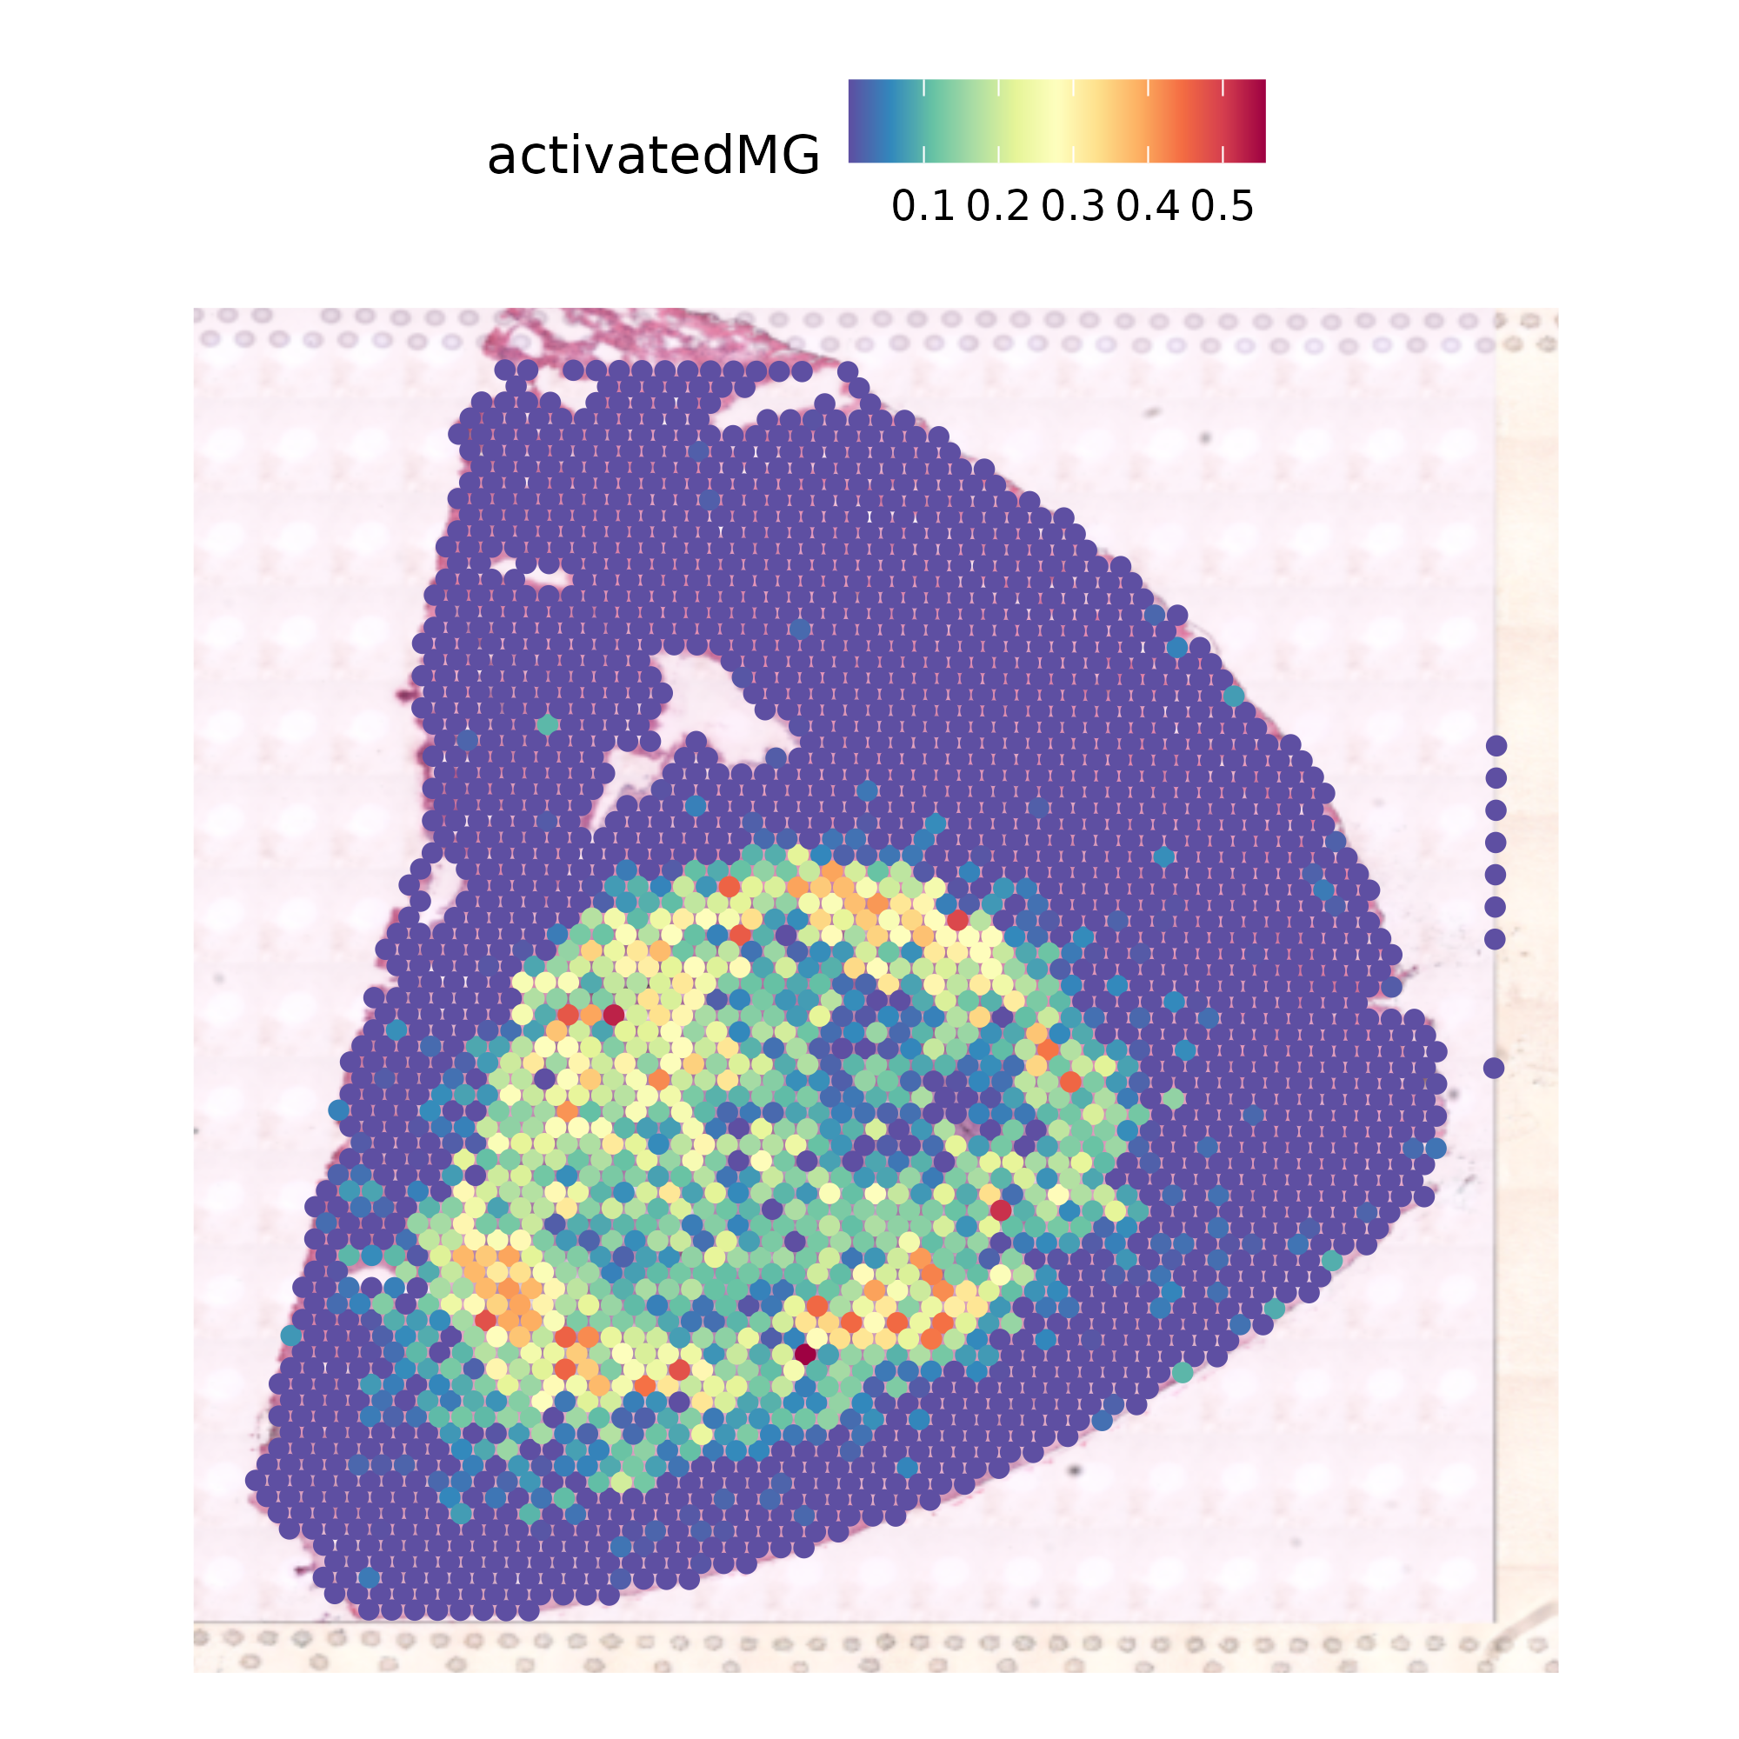
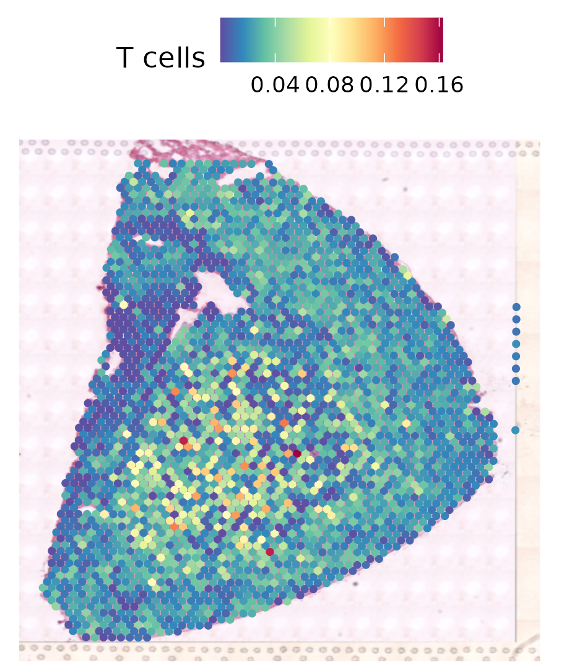
Integration of ST and scRNA seq Data Using robust cell type decomposition (RCTD)
RCTD
scRNA seq Reference dataset
DAM disease associated myeloid cells
Single cell Reference: Ochocka, N., Segit, P., Walentynowicz, K.A. et al. Single-cell RNA sequencing reveals functional heterogeneity of glioma-associated brain macrophages. Nat Commun 12, 1151 (2021).

Slide 9
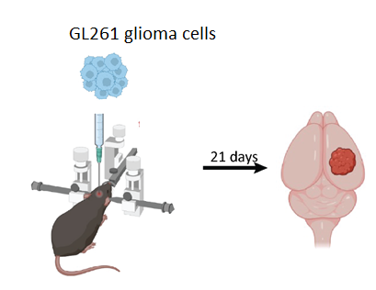
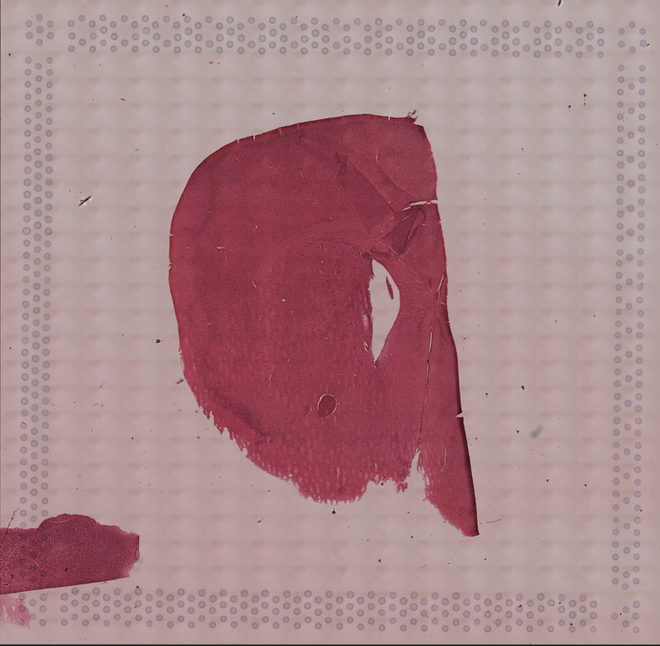
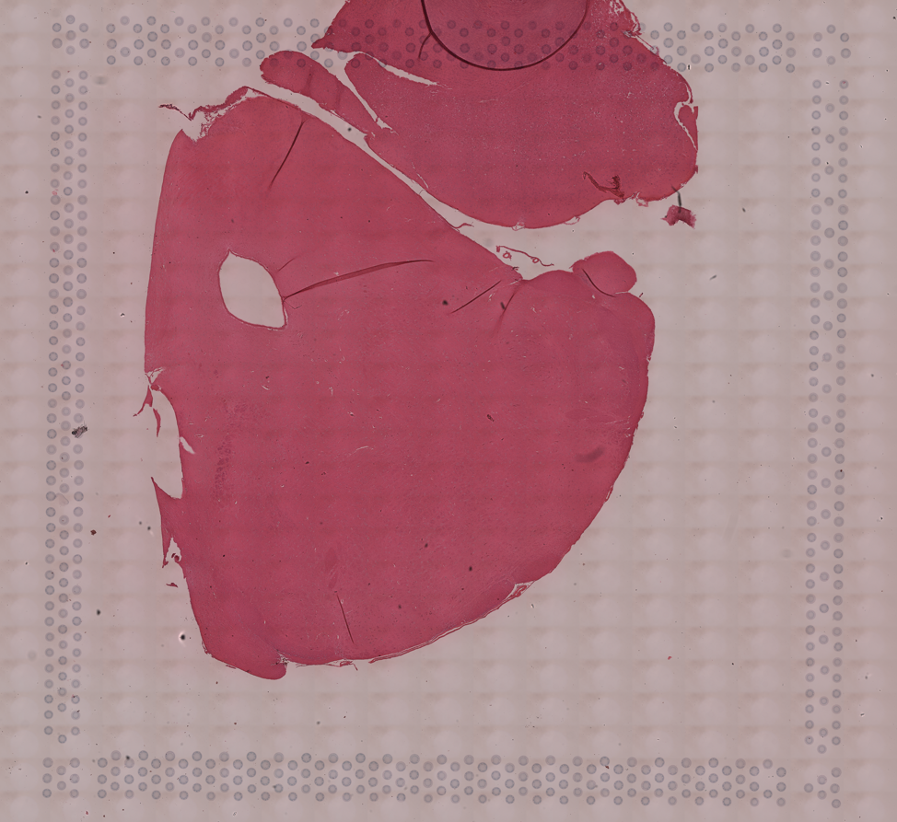
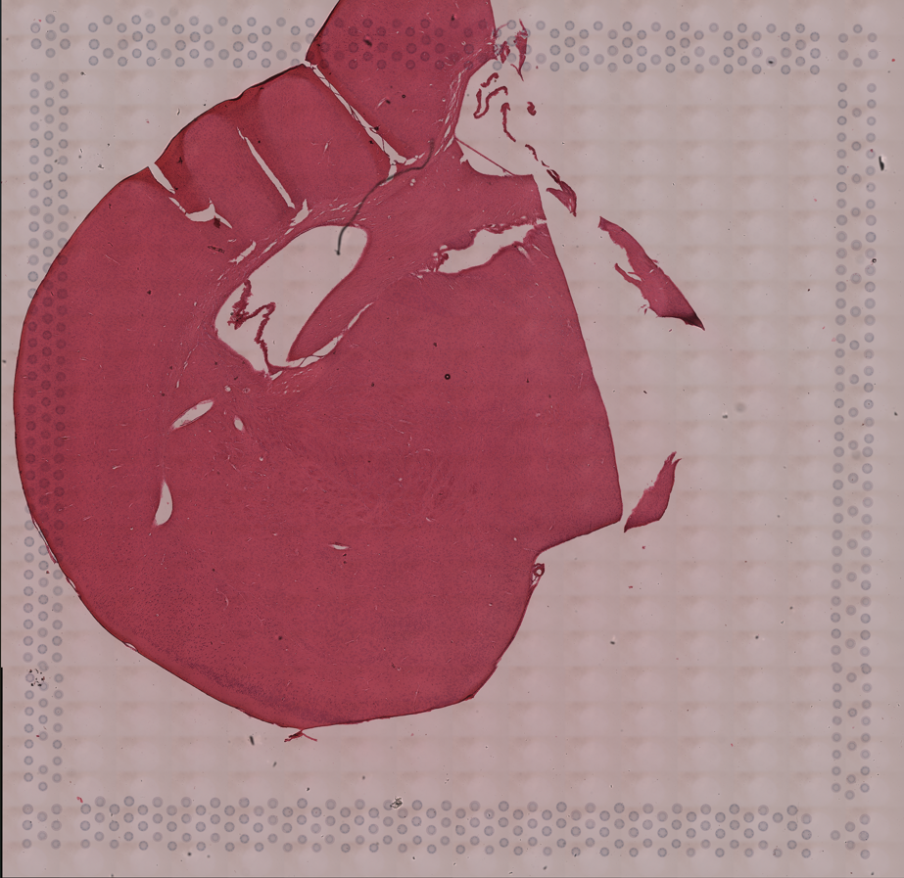
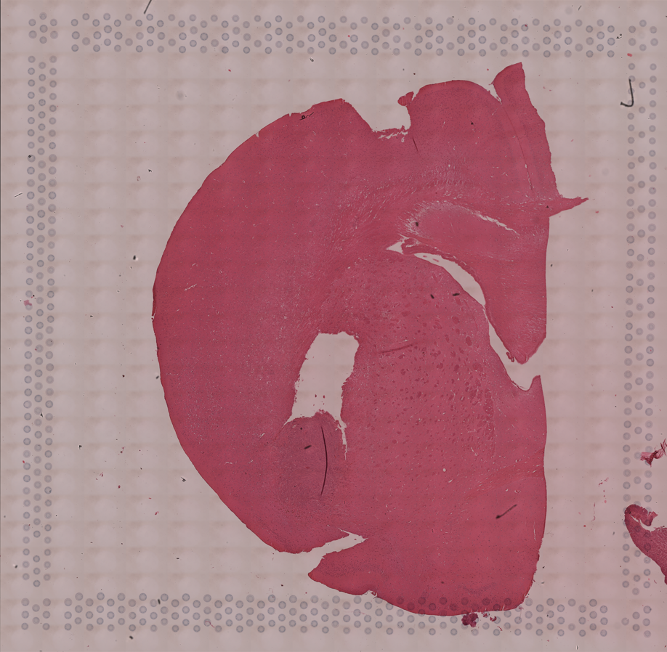

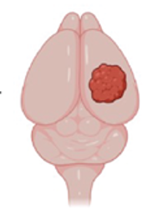
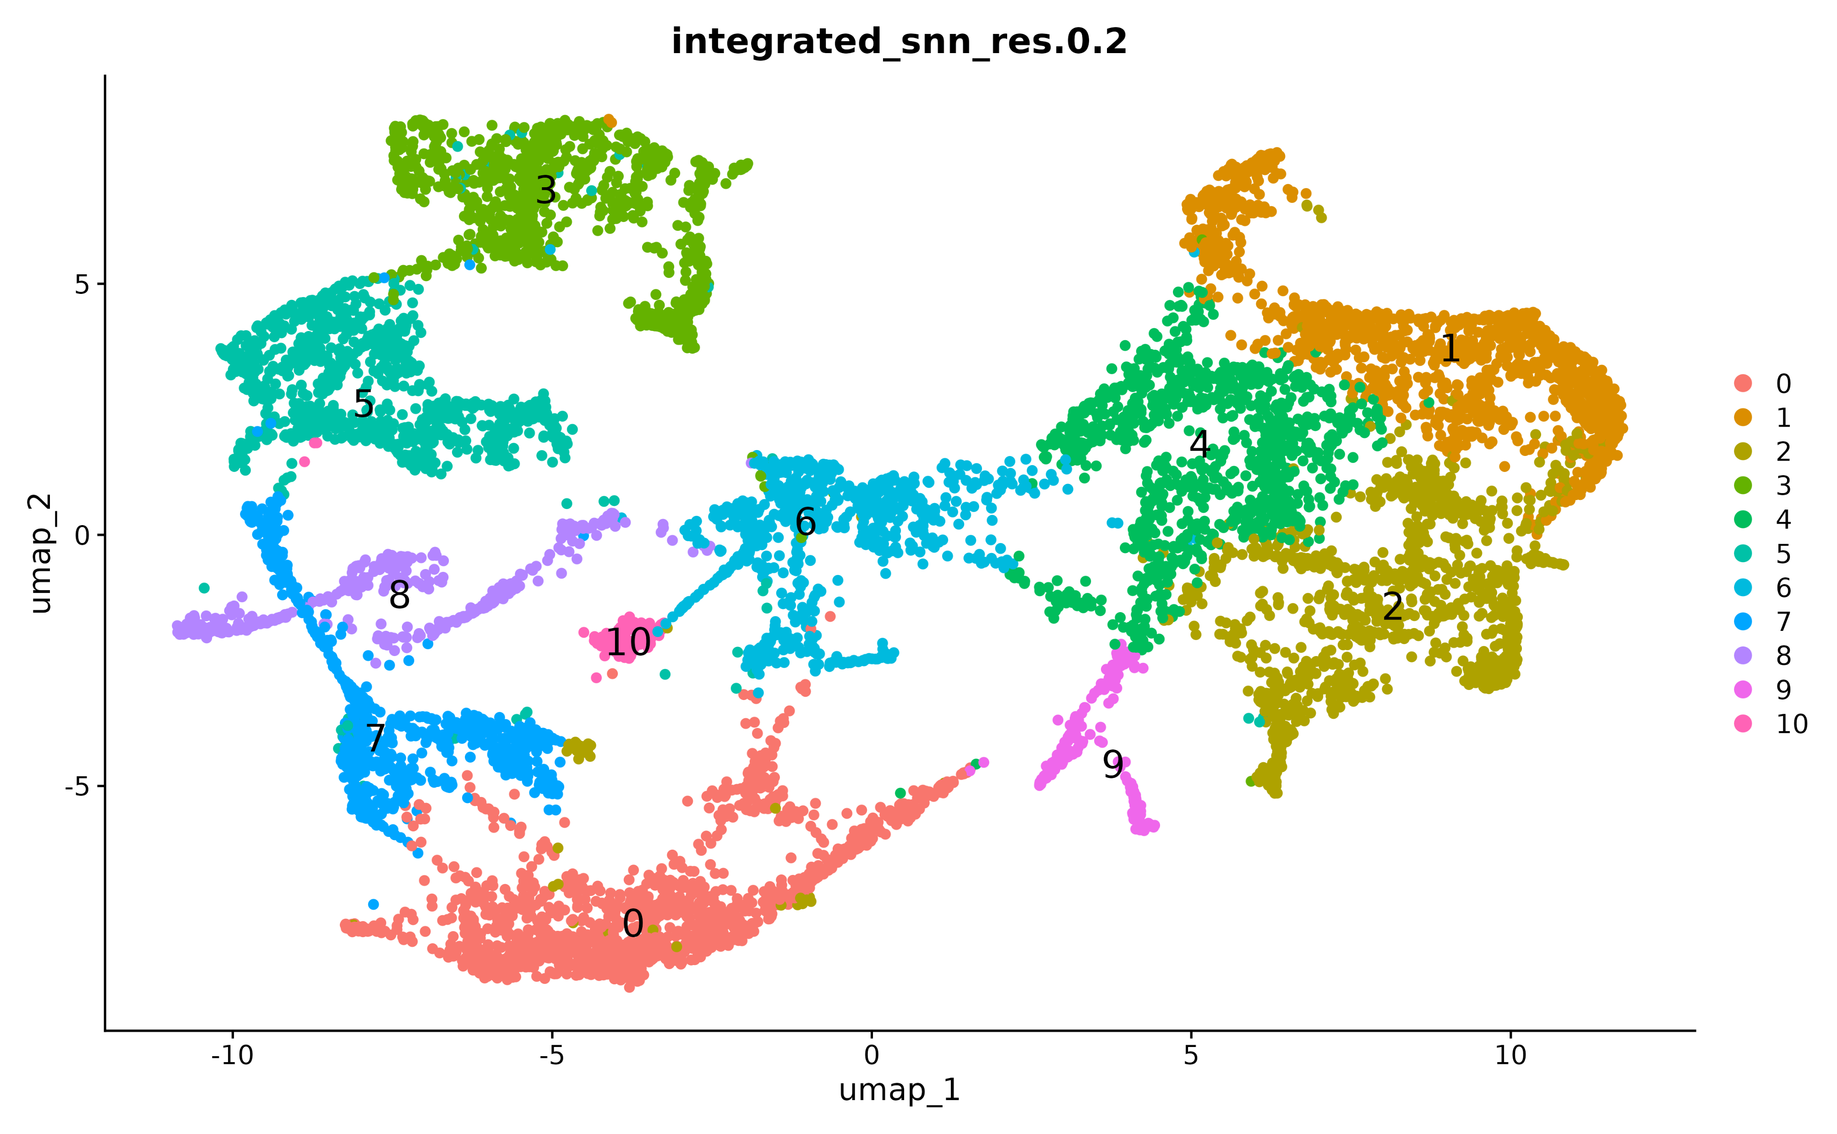
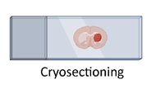
Irradiation Experiment:
Tumor d16
Tumor d21
Irradiation d16
Irradiation d21
Imaging and Sequencing
Clusters
Notes:
Another in vivo experiment in mice was performed using a slightly modified protocol.
GL261 glioma cells were implanted intracranially into the mouse brain. The mice underwent irradiation treatment.
The animals were sacrificed, followed by perfusion, and the brains were collected, fixed in formalin, and embedded in paraffin (FFPE).
Brain sections were then mounted onto 10x Genomics Visium slides, stained, and imaged. Library preparation was performed according to the Visium Spatial Gene Expression protocol, followed by sequencing. The resulting data were subsequently analyzed to assess spatial gene expression in the treated tissue.

Slide 10
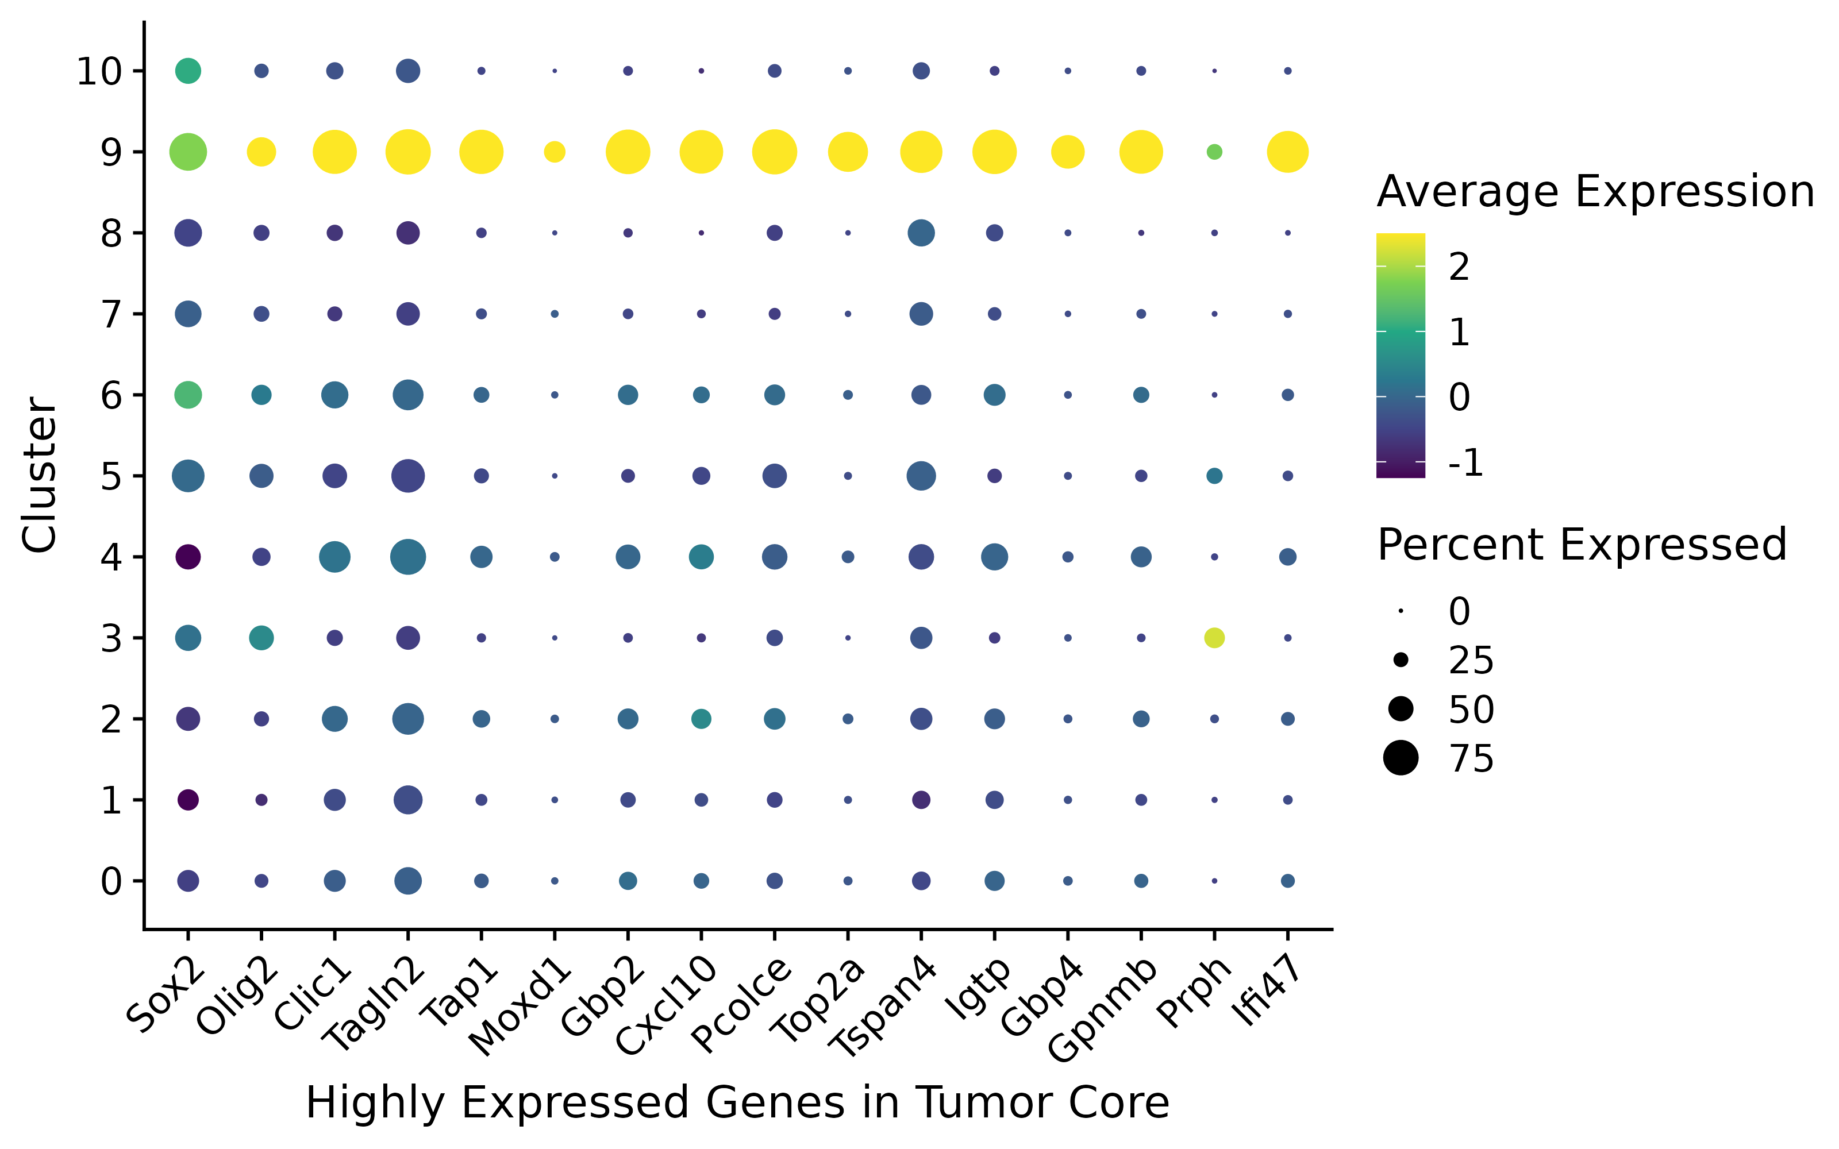
Comparison of highly expressed genes in the tumor core:

Slide 11
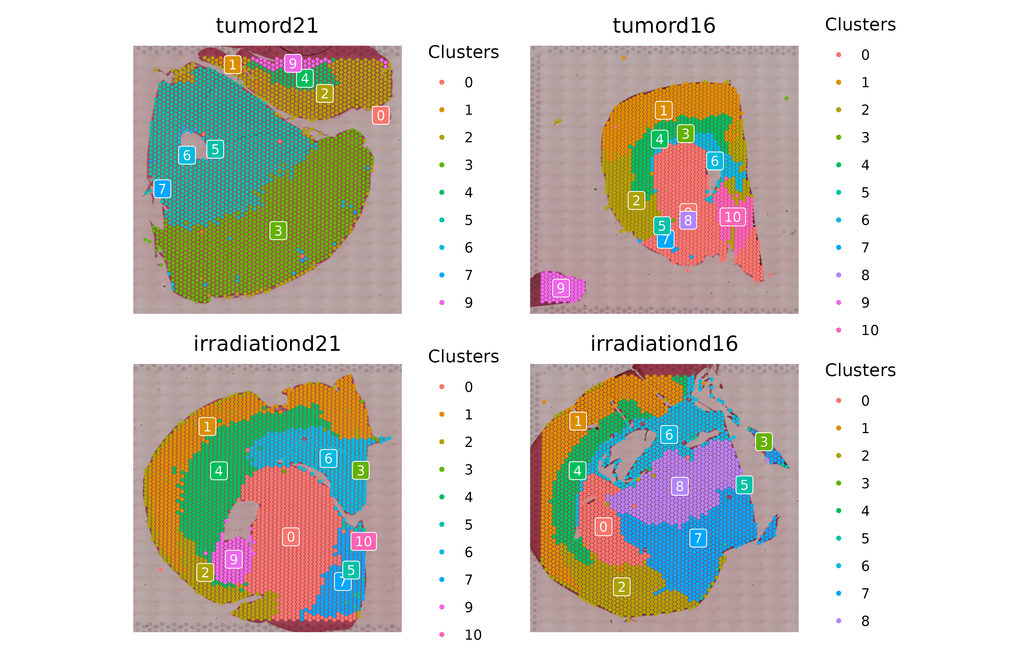
Spatial Mapping of Clusters onto H&E-Stained Tissue Section:

Slide 12
Summary:
DAMs (Disease-Associated Myeloid cells) were the most abundant in the tumor center, indicating that these cells may adopt a phenotype that promotes tumor growth and suppresses anti-tumor immunity.
MDMs (Monocyte-derived macrophages) infiltrate tumors, adopting a tumor supportive state, which suppress immunity and promote vascular growth.
Activated microglia form a ring around the tumor center and may act as pro-tumorigenic cells, promoting tumor proliferation.
Future Work:
We extend this spatial transcriptomic analysis to pediatric high-grade glioma (pHGG).

Slide 13
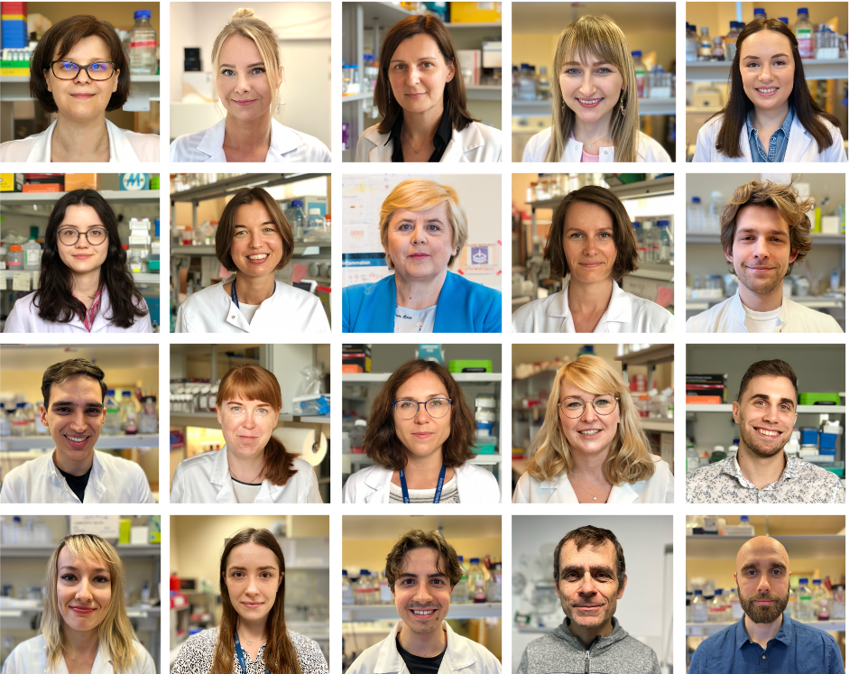
Acknowledgement:
Szymon baluszek, PhD
Anna Lenkiewicz, PhD
Paulina Szadkowska, PhD
Maciej Florczyk , PhD
Natalia Ochocka, PhD
Aleksandra Ellert-Miklaszewska, PhD
Iwona Ciechomska, PhD
Katarzyna Poleszak, PhD
Michał Dąbrowski, PhD,
Yuliana Hovorova, PhD
Beata Kaza, MSc
Paulina Pilanc-Kudlek, MSc
Karol Jacek, MSc
Monika Dźwigońska, MSc
Zuzanna Łuczak-Sobotkowska, MSc
Paulina Kamińska, MSc
Kacper Waśniewski, MSc
Patrycja Rosa, MSc
João Pedro Alves de Araujo, MSc
Szymon Lipiec
Thank you
For your attention!

